Slide 1
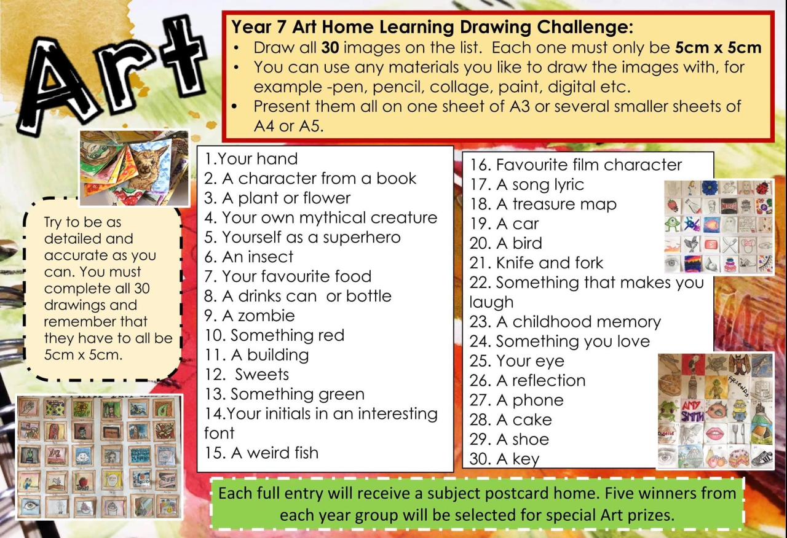
Art, Design and Technology
Each completed Art challenge will be added to a house competition and every student will be entered into a special prize draw. Certificates for every completed entry.

